Slide 1
FUNCTIONS AND ARRAYS
A function is a group of statements or a block of code that is used to perform a particular task.
ex. add(), sub(), sqrt(), area(). Etc
The function contains the set of programming statements enclosed by {}.
ex. add(p1,p2… )
{
statements;
--
}
A function is a set of statements that take inputs, do some specific computation and produces output
Ex. add(2,3)→
input→ 2,3
computation→ addition
result → returns 5 as

Slide 2
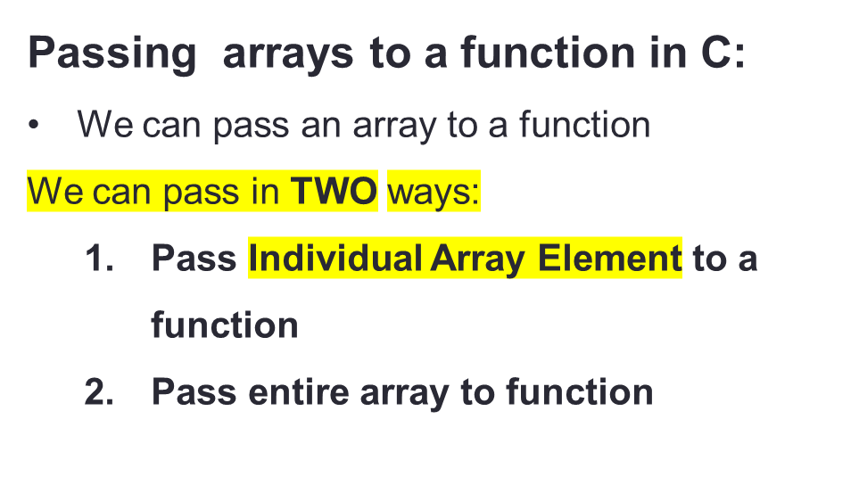
FUNCTIONS AND ARRAYS
1. Pass Individual Array Elements
  Passing array elements to a function is like passing variables to a function.
  Syntax:
  function_name(arrayaname[index_of_element] ) ;
Ex. int a[5]={20,30,40,50}
display(a[1], a[2]);
//passing array individual elements

Slide 3

INPUT:
Enter the array size: 4
Enter array elements: 10 20 30 40
OUTPUT:
Element1: 10
Element2: 10
LOGIC:
Declare and read the array elements int a[4]
Define the function void display(int a1, int a2);
Call the function display( a[0], a[1])
Display the array elements

Slide 4

// PROGRAM TO PASS ARRAY AS A PARAMETER
#include <stdio.h>
void display(int a1, int a2);
int main()
{
int a[4]; int i;
printf(“Ener the array elements \n”);
for(i=0;i<4;i++)
scanf(“%d”, &a[i]);
display(a[1], a[2]); // pass second and third elements to display()
return 0;
}
void display(int a1, int a2)
{
printf(“ Element1 %d\n", a1);
printf(“Element2 %d\n", a2);
}

Slide 5
FUNCTIONS AND ARRAYS
2: Pass entire array to a Function:
Different ways:
-----------------------------------------------------------------------------------------------------------------------------------------
Way 1.
To pass an entire array to a function, only the name of the array is passed as an argument
  Syntax:
  function(arrayname); //PASSING ARRAY NAME ONLY
Ex. Int num[ ]={20,30,40};
caluclate(num);
-----------------------------------------------------------------------------------------------------------------------------------------
Way 2:
  function(arrayname[]) //PASSING ARRAY NAME WITH OUT SIZE
  --------------------------------------------------------------------------------------------------------------
Way 3:
function(arrayname[size]) //PASSING ARRAY NAME WITH SIZE

Slide 6
//PASSING ARRAY DIRECTLY TO FUNCTION
#include <stdio.h>
void printArray(int arr[], int size)
{
int i;
printf("Array elements are: ");
for(i = 0; I < size; i++)
  {
  printf("%d, ",arr[i]);
  }
}
int main()
{
int arr[5]={10,20,30,40,50};
printArray(arr, 5); // Pass array directly to function printArray
return 0;
}

Slide 7
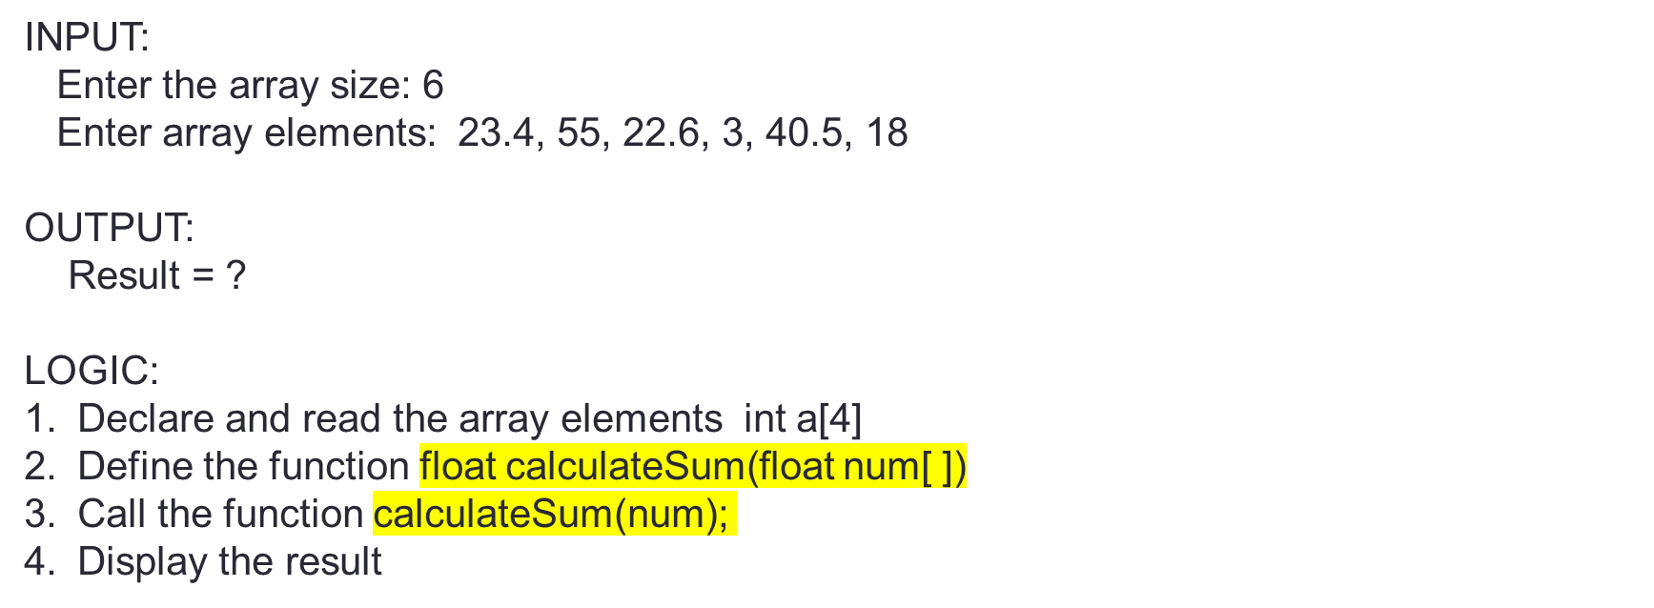
Q)Program to calculate the sum of array elements by passing an entire array to a function

Slide 8
// Program to calculate the sum of array elements by passing to a function
#include <stdio.h>
float calculateSum(float num[ ], int size);
int main()
{
float num[ ] = {23.4, 55, 22.6, 3, 40.5, 18}; float result;
result = calculateSum(num,6);
printf("Result = %.2f",result);
return 0;
}
float calculateSum(float num[ ], int size)
{
float sum = 0.0;
for (int i = 0; i < size; ++i)
{
sum += num[i];
}
return sum;
}

Slide 9
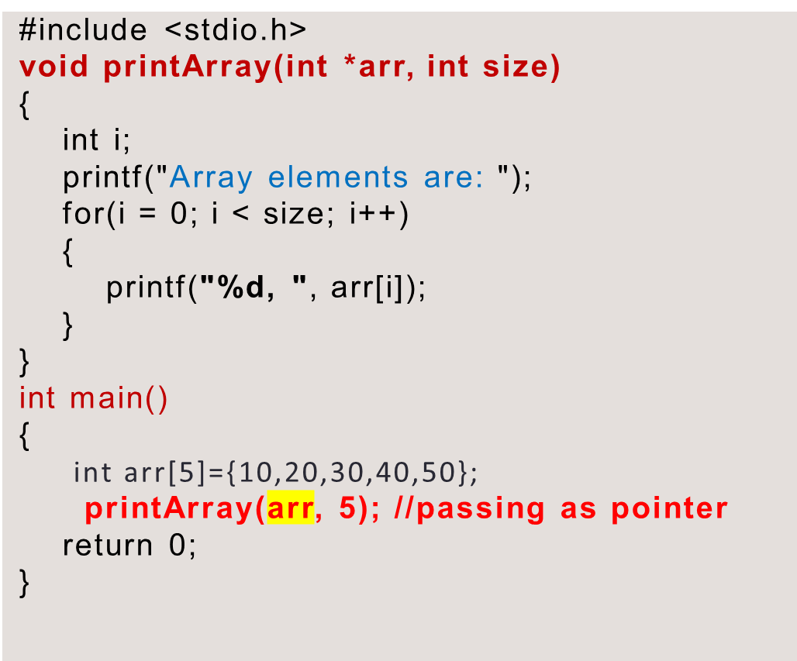
PASSING ARRAY AS A POINTER TO A FUNCTION IN C
Passing array using a pointer to a function:
Since array and pointers are closely related to each other.
Hence you can also pass an array to function as a pointer.
Arrays in C are passed as a reference, not by value. This means any changes to an array within the function will also persist outside the function.

Slide 10
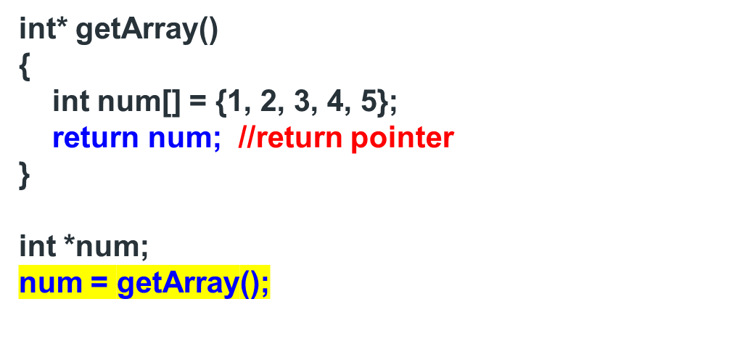
RETURNING AN ARRAY FROM THE FUNCTION
In C you cannot return an array directly from a function. But there are two ways to return an array indirectly from a function.
Return pointer pointing at array from a function

Slide 11
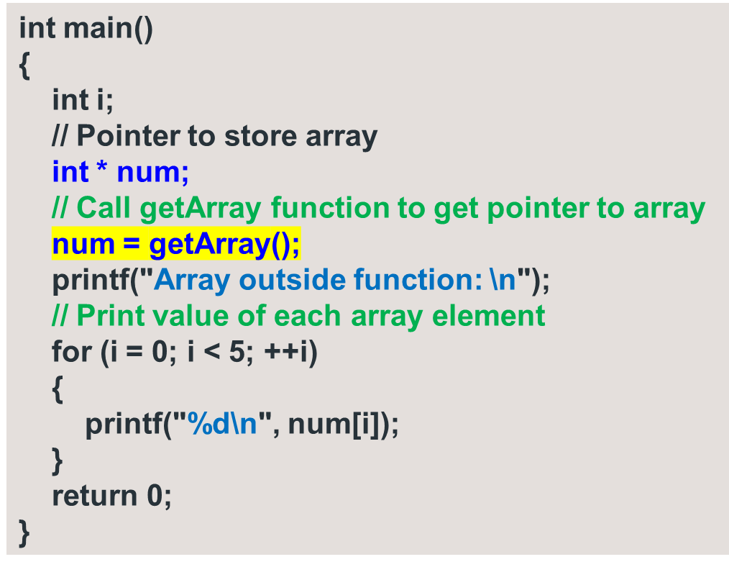
RETURN AN ARRAY FROM THE FUNCTION
#include <stdio.h>
int* getArray()
{
int num[] = {1, 2, 3, 4, 5};
int i;
printf("Array inside function: ");
// Print value of each array element
for (i = 0; i < 5; ++i)
{
printf("%d\n", num[i]);
}
return num; //return array
}

Slide 12
RETURN AN ARRAY FROM THE FUNCTION
Array inside function: 1
2
3
4
5
Array outside function:
1598421552
32764
24
0
12981072
It complains about returning the address of a local variable.
We can return the value of a local variable but it is illegal to return a memory location that is allocated within the function on the stack.
Since, after program control is returned from the function all variables allocated on the stack within the function are freed.
Hence, returning a memory location that is already released will point at no man’s land.

Slide 13
RETURN AN ARRAY FROM THE FUNCTION
#include<stdio.h>
#include<stdlib.h>
int * getArray();
int main()
{
int i;
int * num; // Pointer to store array
num = getArray();
printf("Array outside function: \n");
// Print value of each array element
for(i=0;i<5;++i)
{
printf("%d\n",num[i]);
}
return 0;
}
int * getArray()
{
int *p; int i;
p=(int*)malloc(5*sizeof(int));
// Print value of each array element
printf("Enter the elements of array");
for(i=0;i<5;i++)
{
scanf("%d\n",p+i);
}
return p; //return array
}

Slide 14
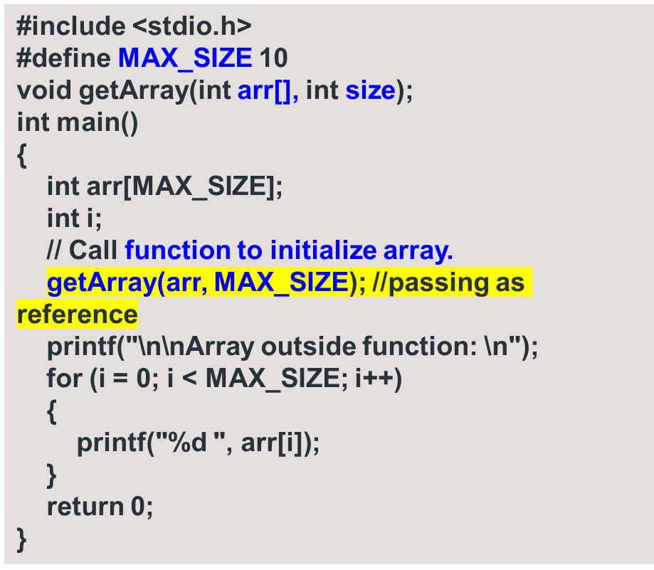
RETURN AN ARRAY FROM THE FUNCTION
void getArray(int arr[], int size)
{
int i;
printf("Enter elements in array: ");
for (i = 0; i < size; i++)
{
scanf("%d", &arr[i]);
}
printf("\nArray inside function: \n");
for (i = 0; i < size; i++)
{
printf("%d ", arr[i]);
}
}
Pass the returned array as a parameter in C
Arrays in C are passed by reference, hence any changes made to an array passed as an argument persists after the function. So, you can accept the output array you need to return, as a parameter to the function.

